Slide 1


e-GMS
Grievance Management System
- Dr. Sanjay V. Deshmukh
Vice Chancellor
University of Mumbai
1
Notes:
Select whichever logo you need

Slide 2
Our Objectives
Simplify the task of lodging and resolving grievances
Improve efficiency of the process
Reduce paperwork
Improve transparency
Reduce the physical intervention needed to pursue the procedure
Ease of handling multiple grievances in a short time
2
e-GMS for Mumbai University 1

Slide 3
Modules
Students
AR
DR
COE
VC
SWD
‹#›
e-GMS for Mumbai University

Slide 4
1. Students
Login to the system with students' PNR number
Change of password
Posting grievances according to respective branch and the corresponding category for that branch.
Constraints on putting random grievances apart from the pre-defined ones.
Viewing progress of pending grievances
‹#›
e-GMS for Mumbai University 2

Slide 5
2. Assistant Registrar (AR)
Login to the system with AR's credentials(Different AR's have different credentials)
Change of password
Viewing grievances under the respective AR’s domain only
Reply to grievances by clicking on the reply button corresponding to the grievance mentioned.
‹#›
e-GMS for Mumbai University 3

Slide 6
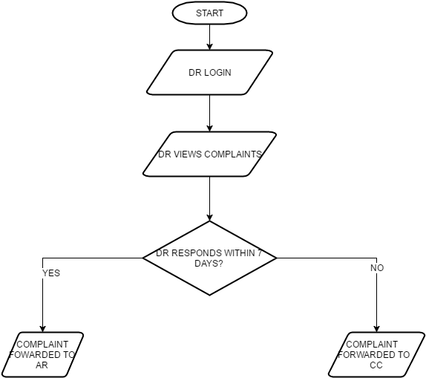
3. Deputy Registrar (DR)
Login to the system with DR's credentials
Change of password
Receiving grievances which are not attended by the AR for 7 days
Notifying the AR about the grievances again
‹#›
e-GMS for Mumbai University 4

Slide 7
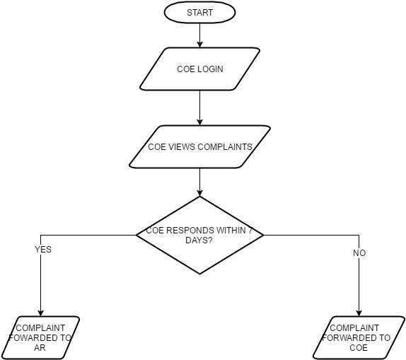
4. Controller of Examinations (COE)
Login to the system with COE’s credentials
Change of password
Receiving grievances which are not attended by the AR for 7 days and also not attended by the DR for 7 days
Notifying the DR about the grievances again
‹#›
e-GMS for Mumbai University
e-GMS for Mumbai University 5

Slide 8
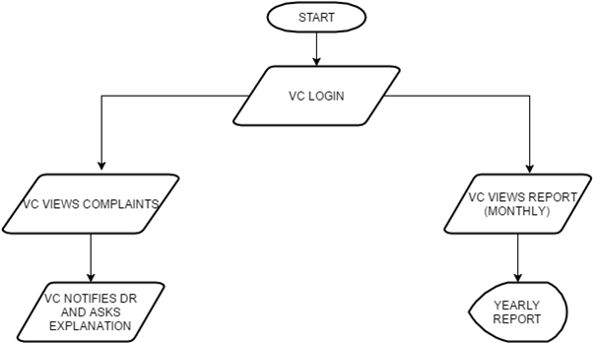
5. Vice Chancellor (VC)
Login to the system with VC’s credentials,& change of password
Receiving grievances not attended by the AR for 7 days, by the DR for 7 days and also by the COE for 7 days
Replying to grievances by notifying DR of the concerned section
Viewing the grievance management statistics on year by year basis
‹#›
e-GMS for Mumbai University
e-GMS for Mumbai University 6

Slide 9
6. Students Welfare Department (SWD)
Login to the system with SW’s credentials
Change of password
Monitoring both pending and attended grievances
Reviewing attended grievances flagged as solved or unsolved by the user
‹#›
e-GMS for Mumbai University 6
e-GMS for Mumbai University

Slide 10
Overall Flow Diagram
‹#›

Slide 11
‹#›
e-GMS for Mumbai University

Slide 12
ScreenShots

Slide 13
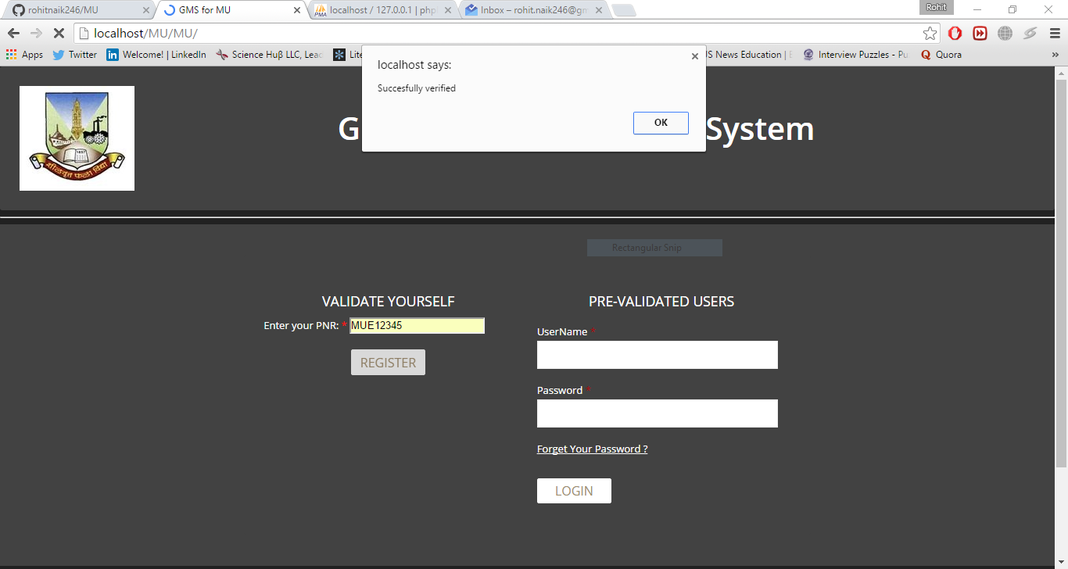
LOGIN FUNCTIONALITY
Fig 1: Home Page
‹#›
e-GMS for Mumbai University

Slide 14
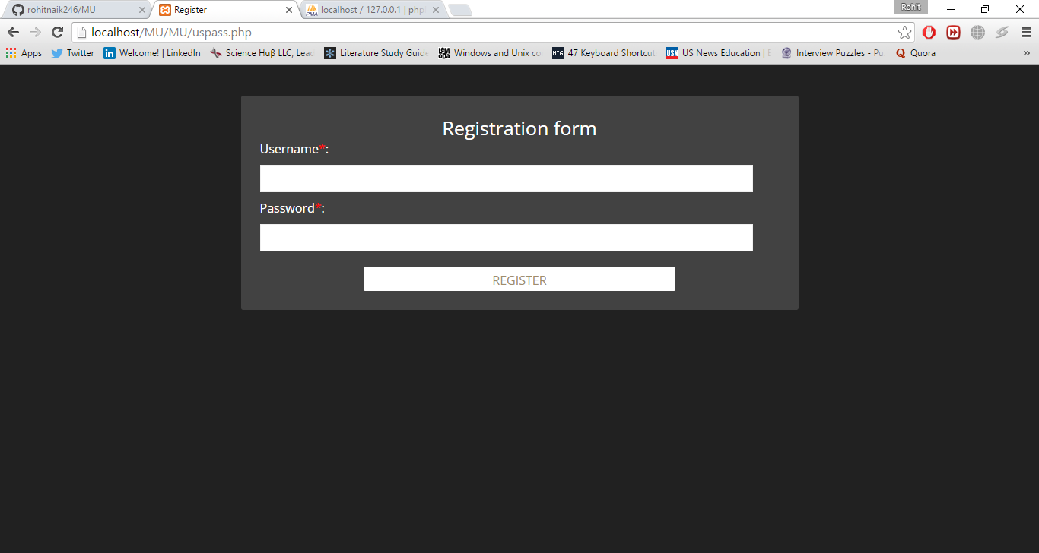
REGISTRATION FORM
Fig 2: Registration Form
‹#›
e-GMS for Mumbai University 6

Slide 15
Students’ View

Slide 16
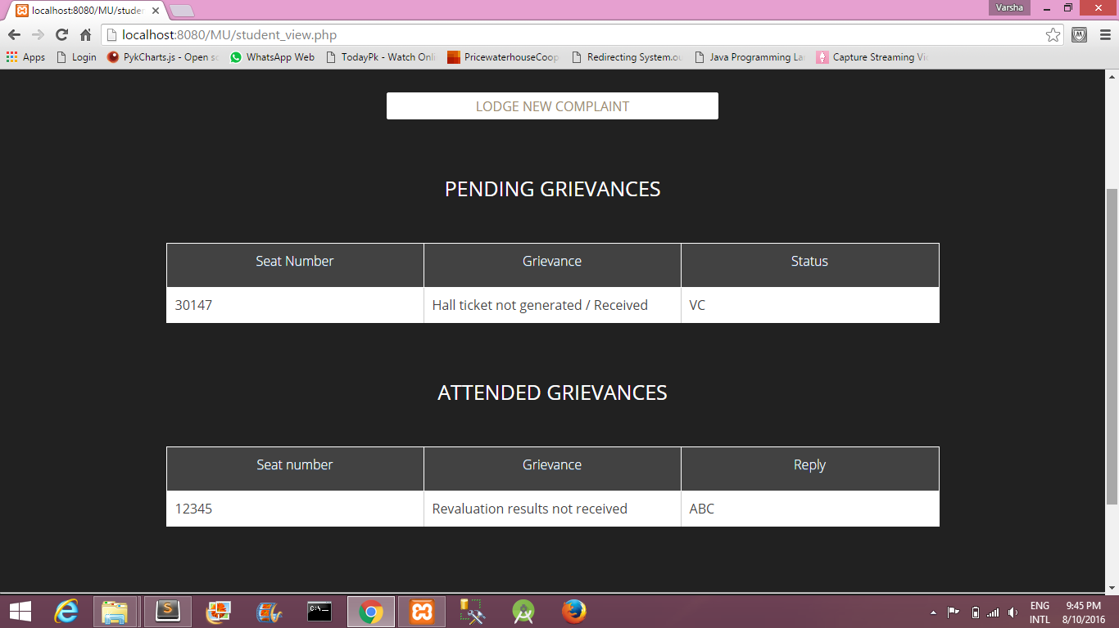
PENDING AND ATTENDED COMPLAINTS
Fig 3: Details of pending and attended complaints for the student
‹#›
e-GMS for Mumbai University 6

Slide 17
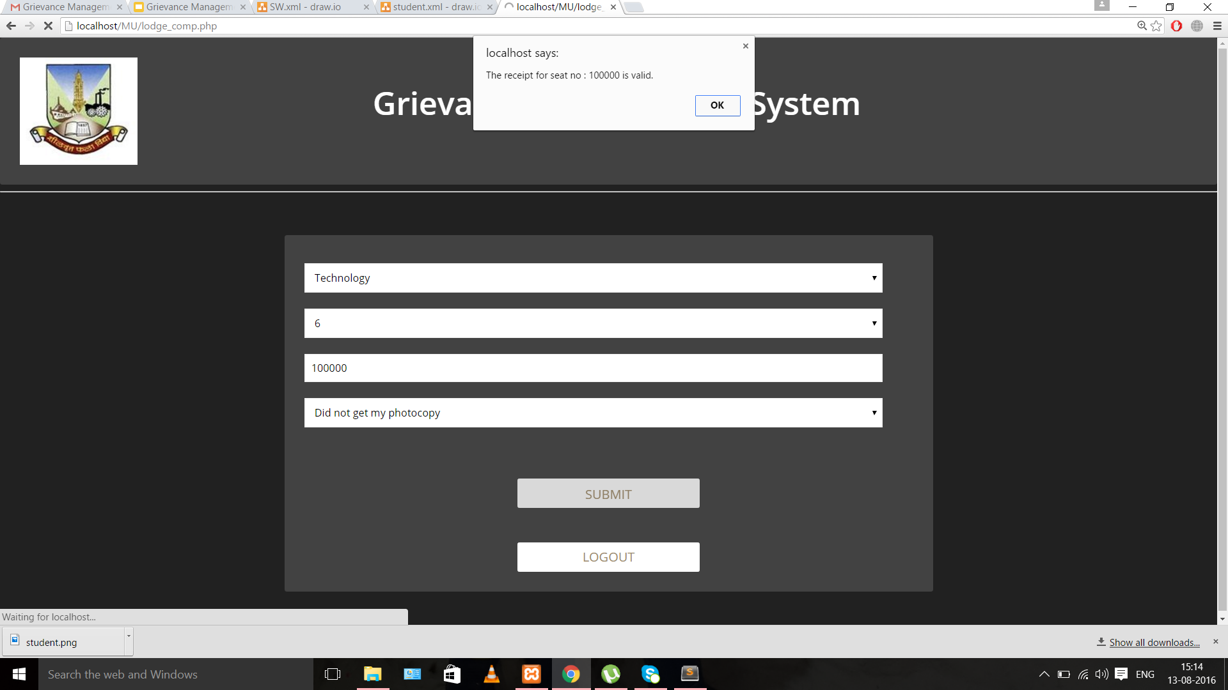
LODGE A NEW GRIEVANCE FORM
Fig 4: Lodge New Grievance Form
‹#›
e-GMS for Mumbai University 6

Slide 18
Student Welfare Department’s View

Slide 19
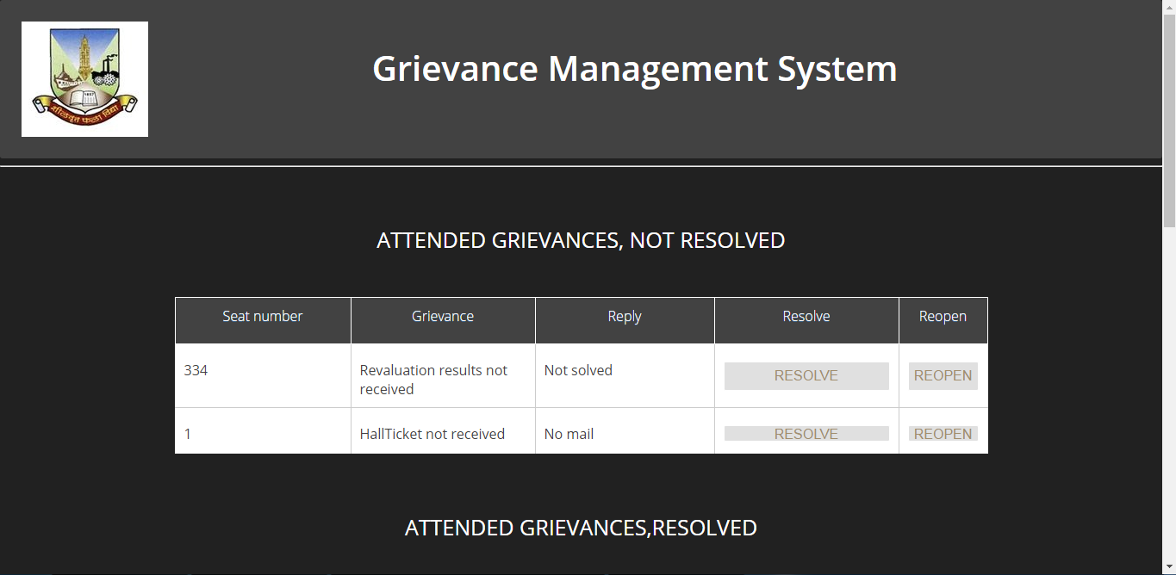
DETAILS OF GRIEVANCES ATTENDED, BUT NOT RESOLVED
Fig 5.1: Details of grievances attended, but not resolved and an option to resolve them
‹#›
e-GMS for Mumbai University 6

Slide 20
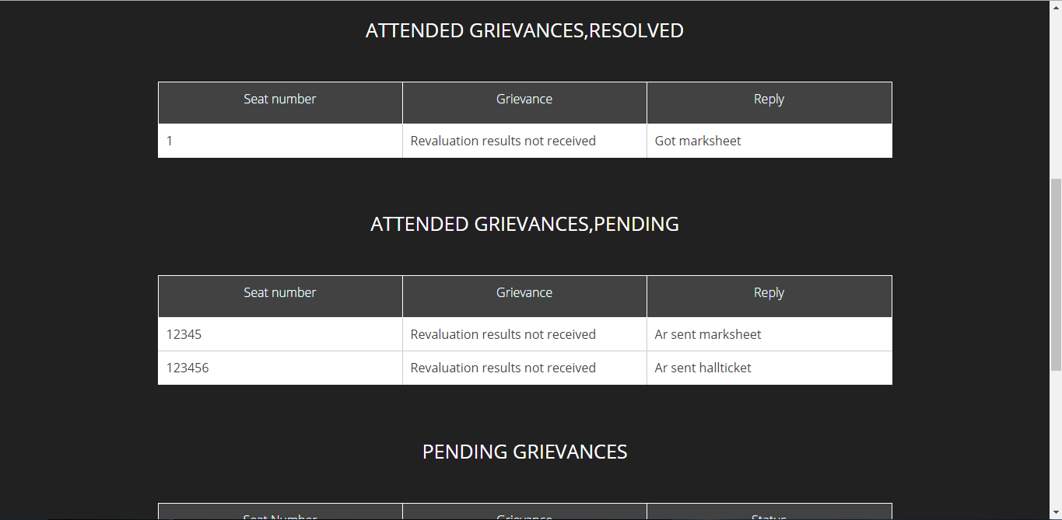
GRIEVANCES ATTENDED AND RESOLVED
Fig 5.2: Details of Attended grievances
‹#›
e-GMS for Mumbai University 6

Slide 21
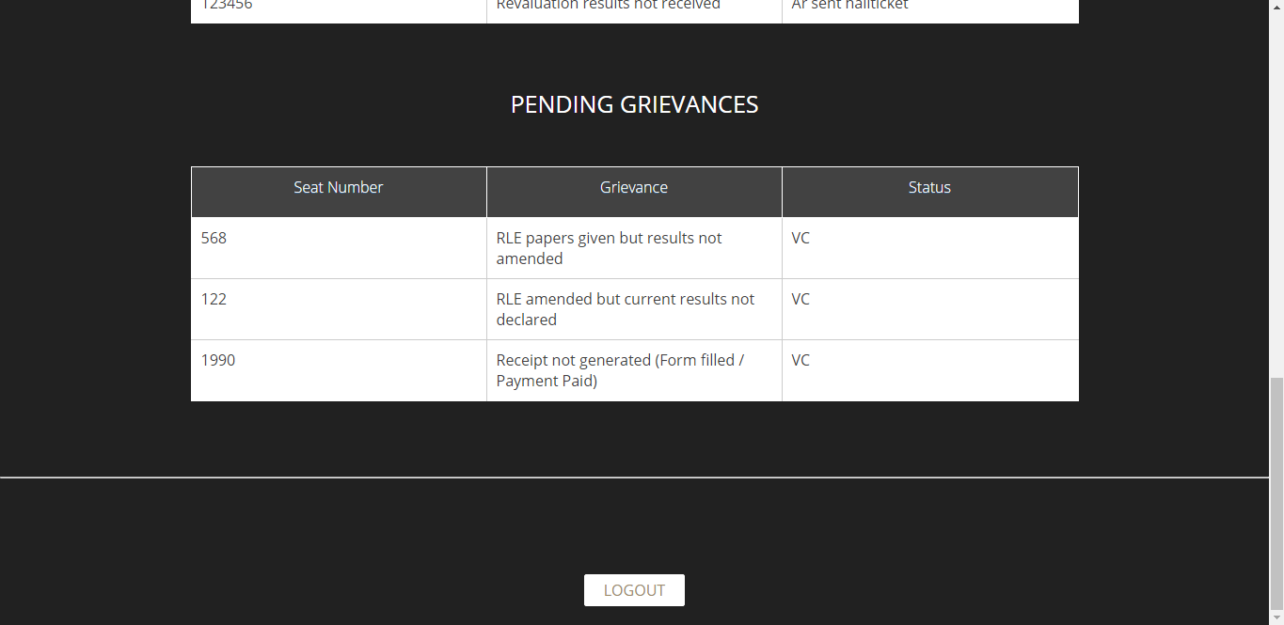
PENDING GRIEVANCES
Fig 5.3: Details of Pending grievances
‹#›
e-GMS for Mumbai University 6

Slide 22
AR’s View

Slide 23
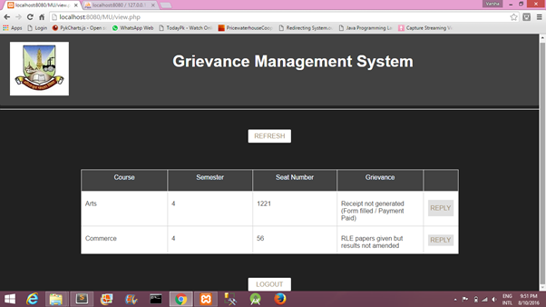
GRIEVANCES PENDING BY AR
Fig 6: Details of grievances under AR with an option to reply for every grievance
‹#›
e-GMS for Mumbai University 6

Slide 24
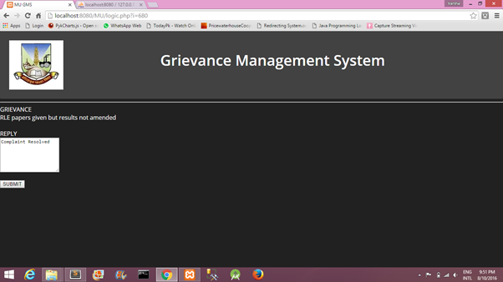
REPLY TO A GRIEVANCE
Fig 7: Reply form for AR. The reply is forwarded to the SWD
‹#›
e-GMS for Mumbai University 6

Slide 25
DR’s View

Slide 26
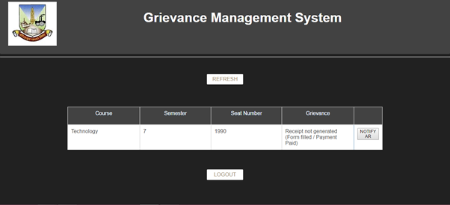
GRIEVANCES PENDING BY DR
Fig 8: Details of grievances under DR with an option to Notify AR for every grievance
‹#›
e-GMS for Mumbai University 6

Slide 27
VC’s View

Slide 28
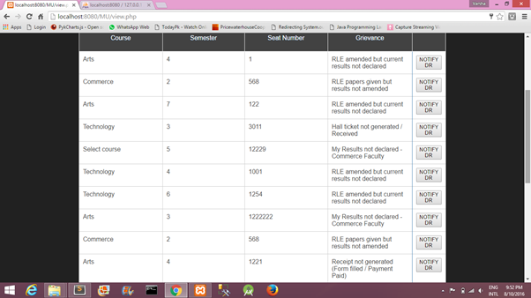
GRIEVANCES UNATTENDED BY AR,DR AND COE
Fig 9: Details of grievances under VC with an option to Notify DR for each grievance
‹#›
e-GMS for Mumbai University 6

Slide 29
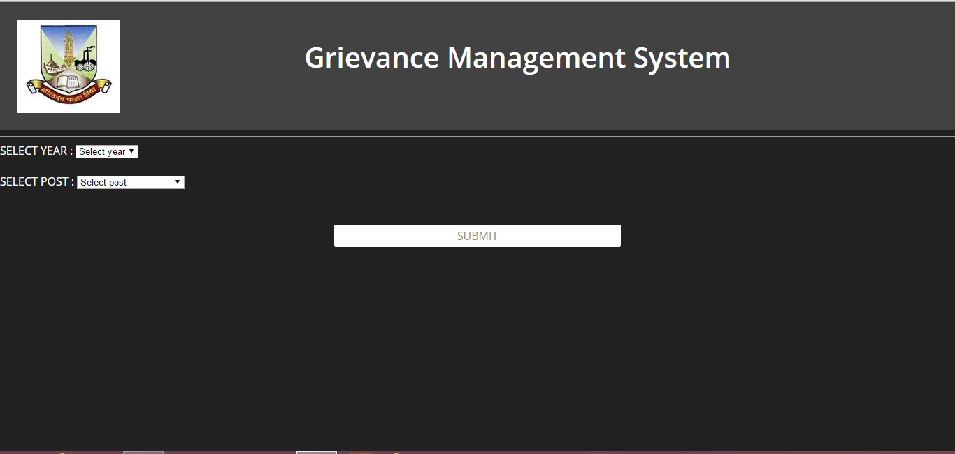
SELECT YEAR AND POST TO VIEW REPORT
Fig 10: Selection of year and post to view report
‹#›
e-GMS for Mumbai University 6

Slide 30
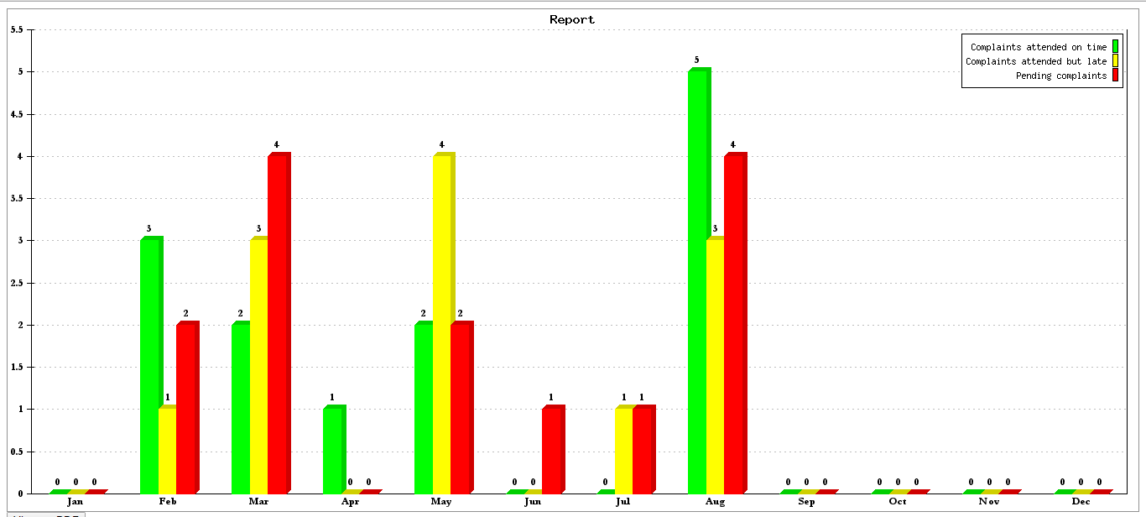
REPORTS FOR THE SELECTED YEAR AND POST
Fig 11: Graph displaying monthly records according to the selected year
‹#›
e-GMS for Mumbai University 6

Slide 31
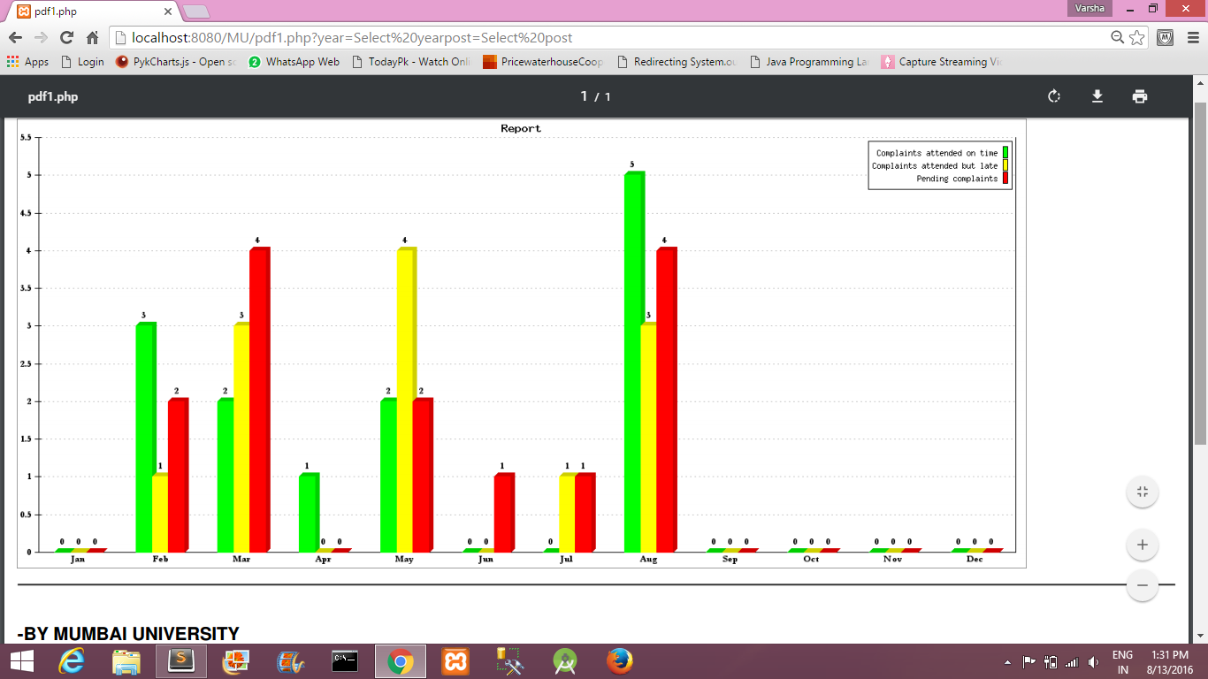
VIEW REPORTS AS PDF
Fig 12: View reports as PDF and functionality to download it
‹#›
e-GMS for Mumbai University 6

Slide 32
Digital Partner :
Computer Engineering Department,
Sardar Patel Institute of Technology,
Mumbai
‹#›
e-GMS for Mumbai University 6

